Slide 1
Google Charts
21127005 - Lê Trọng Đức Anh
21127165 - Ngô Đình Quốc Tháng
21127571 - Huỳnh Vĩnh Đồ
21127574 - Phan Trương Quý Hòa

Slide 2
TABLE OF CONTENTS
What is GG Charts and how to use
Comparison with some Visualization Solutions
01
03
Different charts and its uses
Demo
02
04

Slide 3
What is GG Charts and how to use
01

Slide 4

What is Google Chart?
User-friendly data visualization tool by Google.
Simplifies creating interactive charts for web apps.
Offers various chart types and customization options.

Slide 5
How To Use?
The core component of Google Charts is its library written in JavaScript which provides a set of APIs for creating various types of charts.
Google Charts supports a variety of chart types, including line charts, bar charts, pie charts, scatter plots,...Each chart type is designed to represent different types of data.

Slide 6
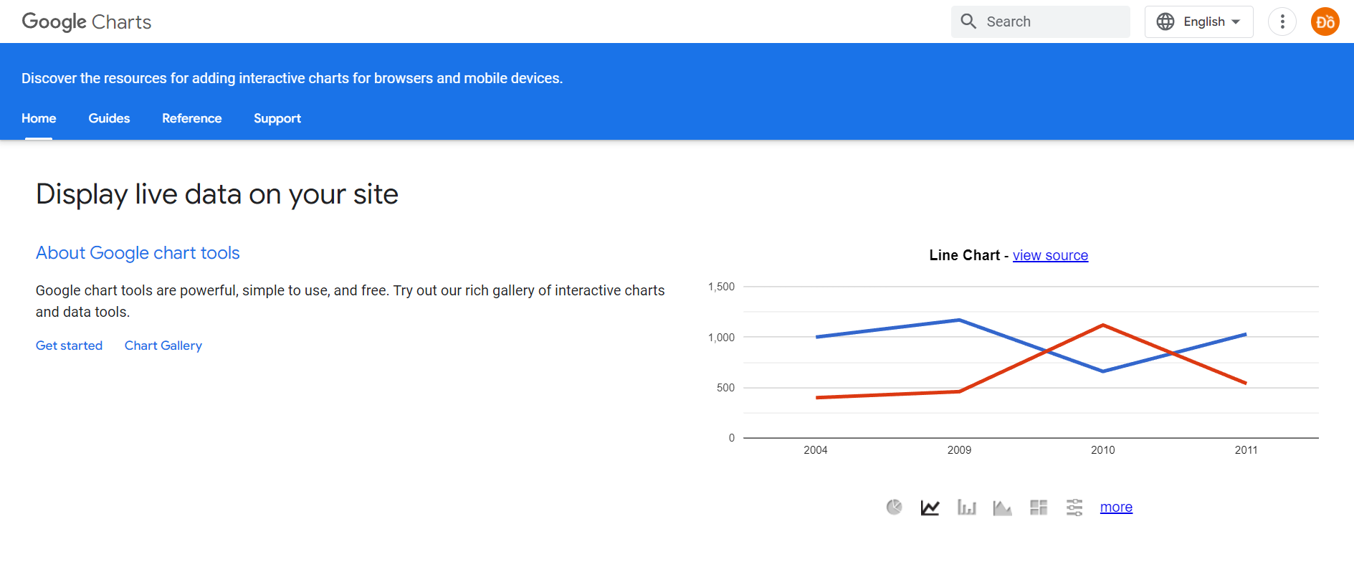
How To Use?

Slide 7
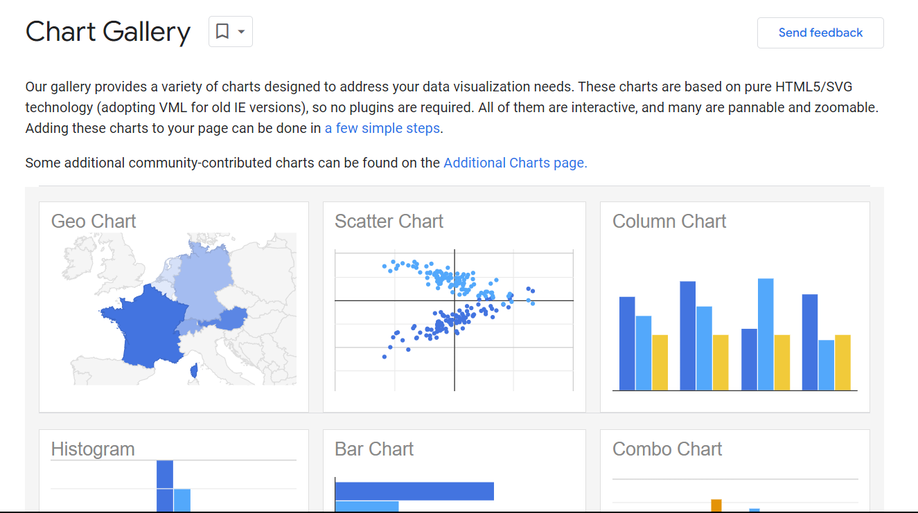
How To Use?

Slide 8
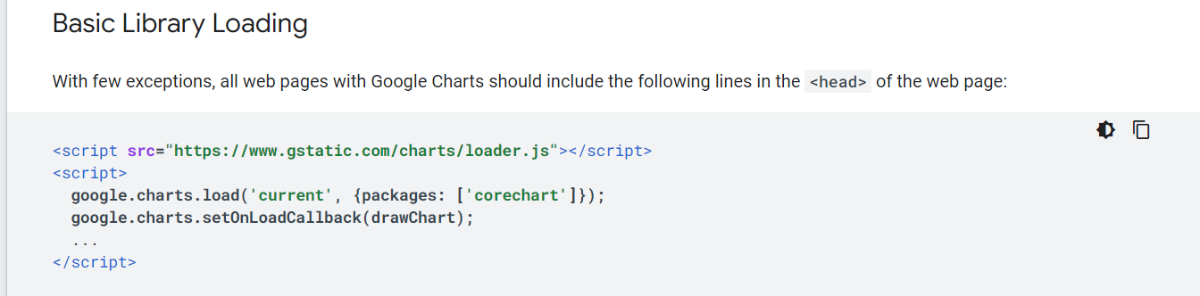
How To Use?
Load the Libraries

Slide 9
How To Use?
2. Prepare the Data
All charts require data. Google Chart Tools charts require data to be wrapped in a JavaScript class called google.visualization.DataTable. This class is defined in the Google Visualization library that you loaded previously.
A DataTable is a two-dimensional table with rows and columns, where each column has a datatype, an optional ID, and an optional label.

Slide 10
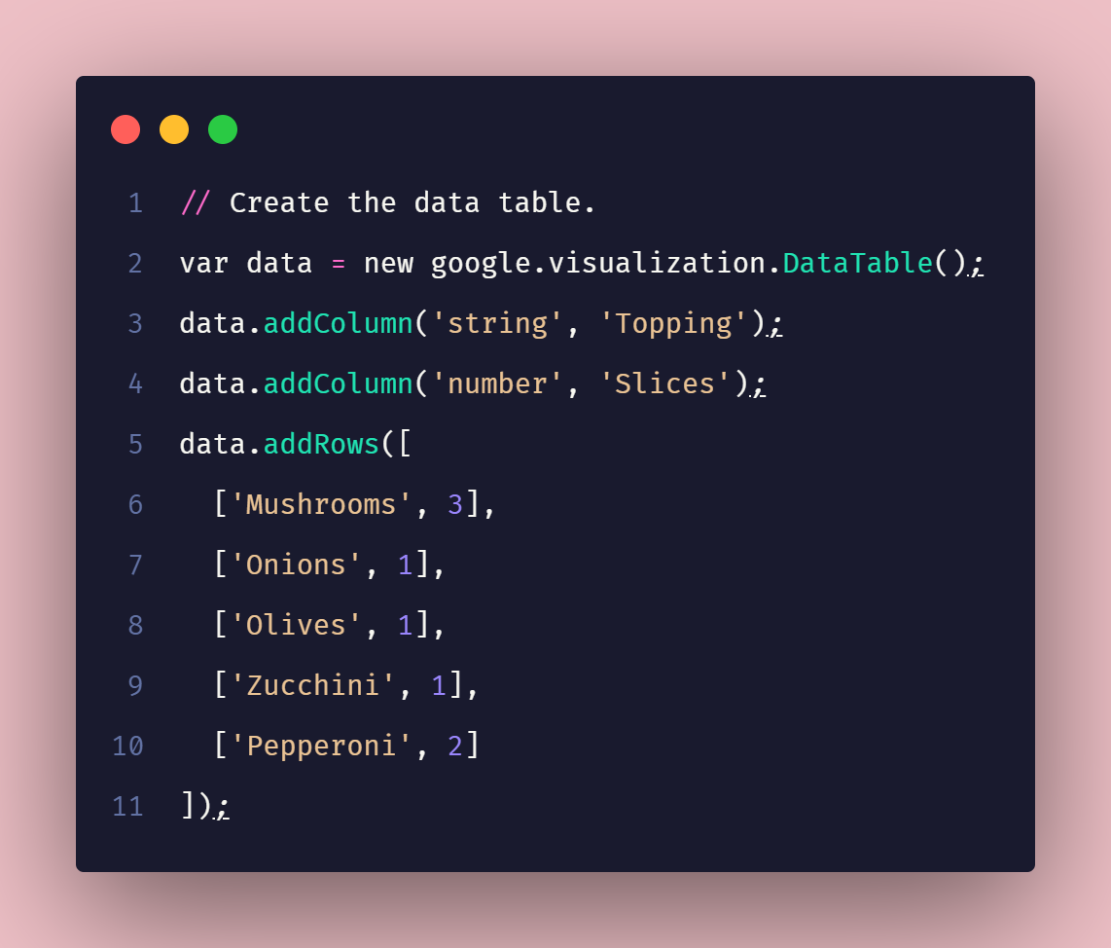
How To Use?
2. Prepare the Data

Slide 11
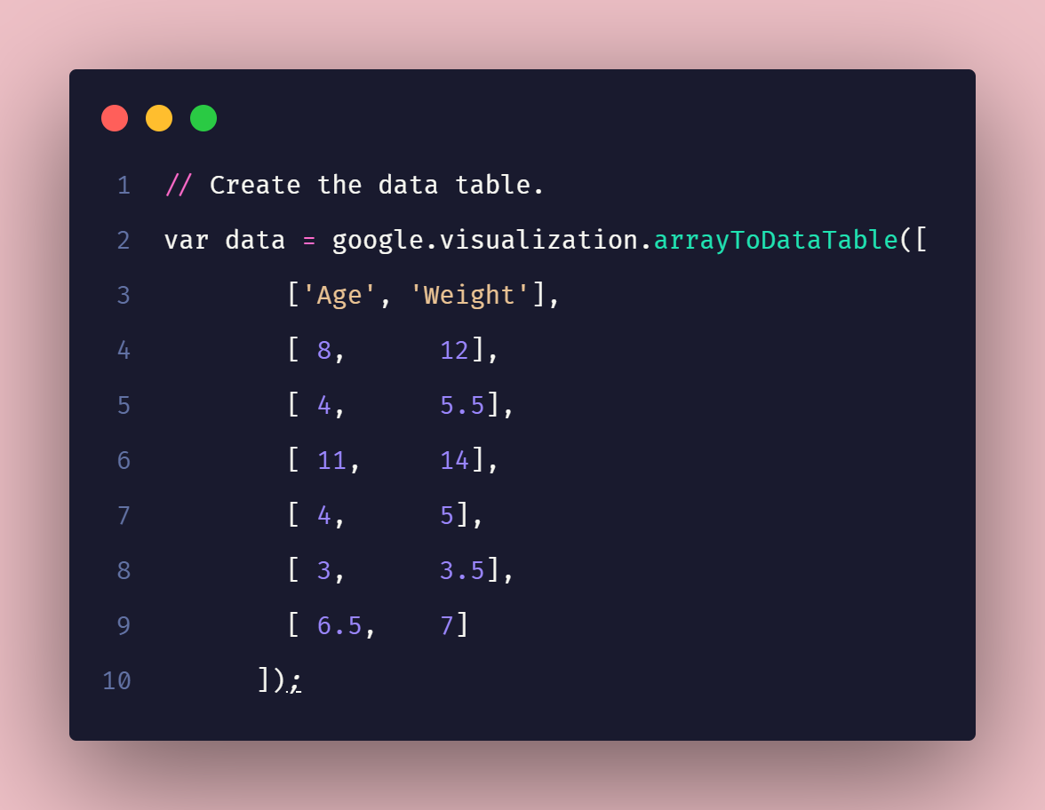
How To Use?
2. Prepare the Data

Slide 12
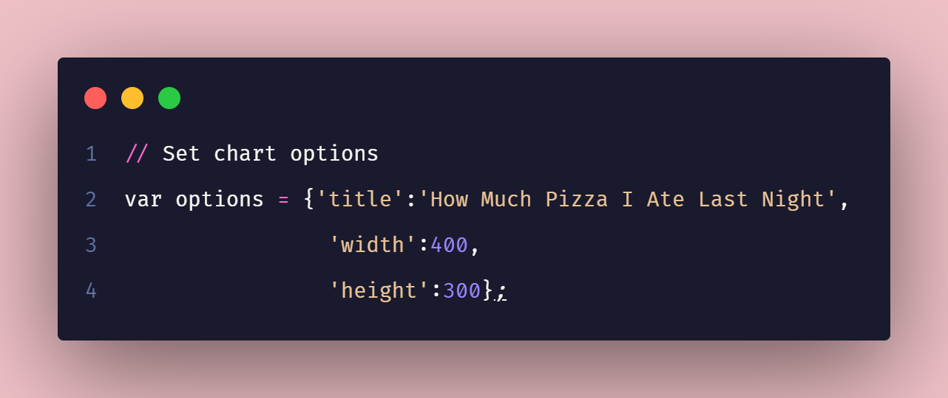
How To Use?
3. Customize the Chart

Slide 13
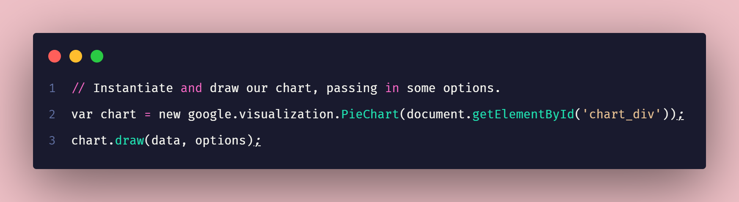
How To Use?
4. Draw the Chart

Slide 14
Different charts and its uses
02

Slide 15
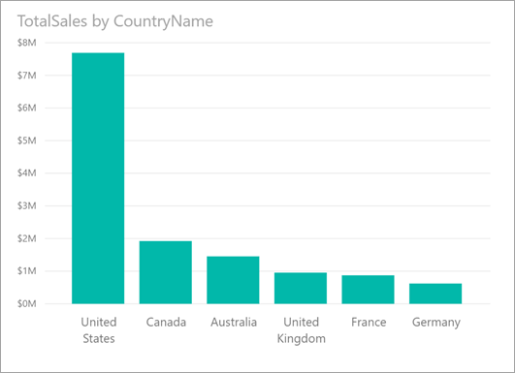
Bar Chart
Title: Compare Categories
X-axis: Category Labels
Y-axis: Value
Use for: Comparing values across different categories.

Slide 16
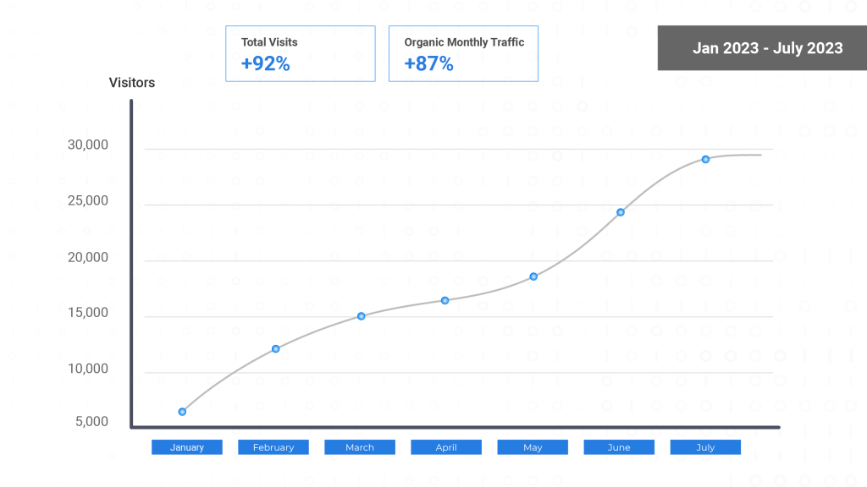
Line Chart
Title: Track Trends Over Time (e.g., Website Traffic)
X-axis: Time (e.g., Months)
Y-axis: Value (e.g., Visitors)
Use for: Showing trends and patterns over time.

Slide 17
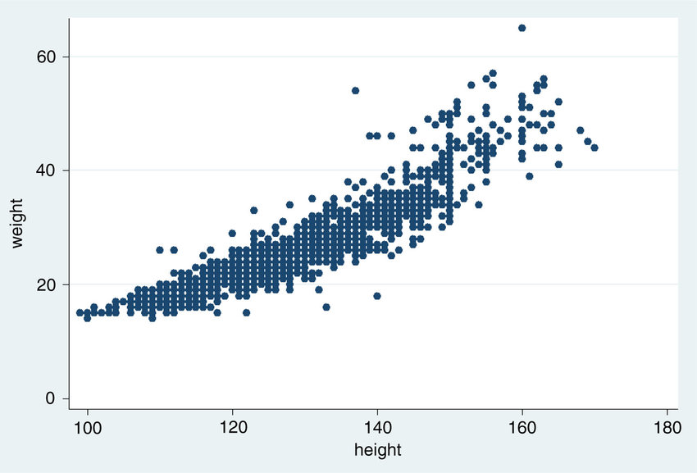
Scatter Plot
Title: Explore Relationships (e.g., Height vs Weight)
X-axis: Independent Variable (e.g., Height)
Y-axis: Dependent Variable (e.g., Weight)
Use for: Identifying correlations between two variables.

Slide 18
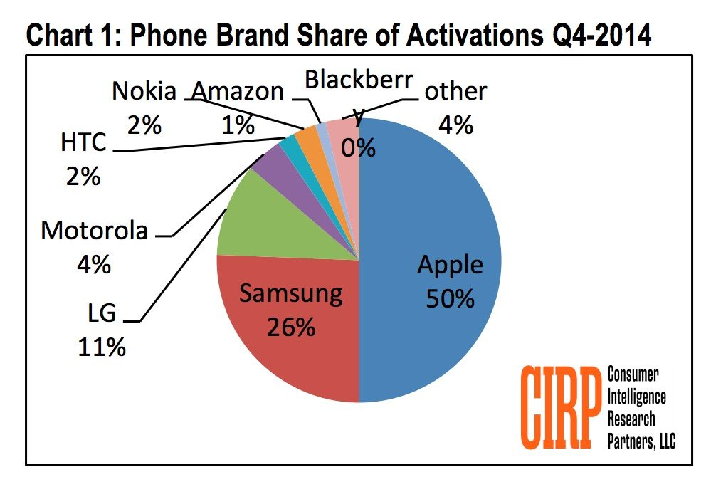
Pie Chart
Title: Show Part of a Whole
Slices: Categories
Use for: Visualizing the composition of a whole

Slide 19
Comparison of Visualization Solutions in Big Data
03

Slide 20



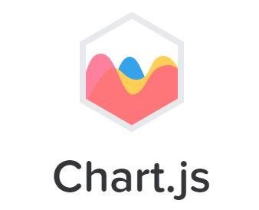

Type of tools | Software | JS library | Python/R/Julia Library | JS library | JS library
Ease of use | Drag and drop | More manually coding | User-friendly, may require experience | Simple JS syntax | Simple JS syntax
Customization | High | High | High | Moderate | Moderate
Interactivity | High | High | High | High | Moderate
Real time data handling | Yes | Yes | Yes | No | No
Cost | Free/Paid | Free | Free | Free | Free
Community Support | Large | Large | Large | Large | Large

Slide 21
Demo
04

Slide 22
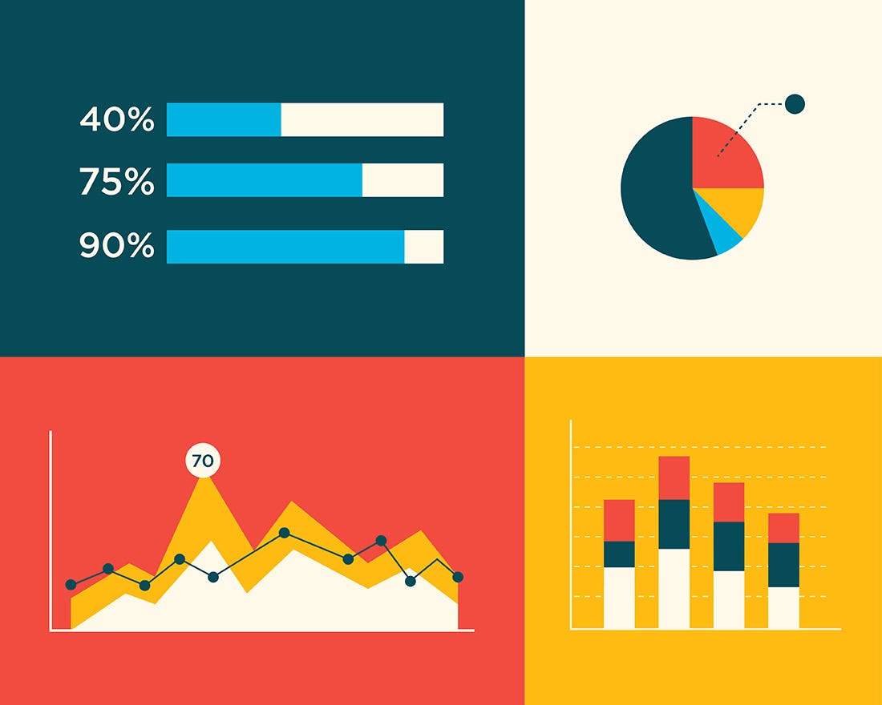
Handling large dataset in visualization
Data sampling: random, clustering, convenience sampling
Data aggregation before visualizing
Server-side processing: using distributed systems like hadoop or Spark to pre-process the data before visualizing

Slide 23
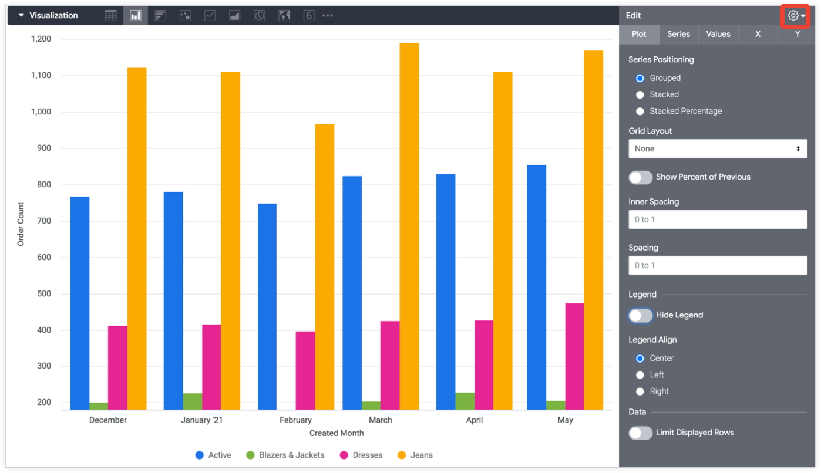
Google Charts supports
Pagination: visualizing into smaller chunks
Data grouping: grouping similar data points into a chart
Client-side Filtering: Google charts allows user what they want to see

Slide 24
Key points to remember when handling big dataset
Focus on Communication: don’t forget what the chart is delivering
Prioritize Techniques: sampling, aggregation, or server-side processing before feeding data to Google Charts
Optimize the User Experience: features like pagination, grouping, and filtering to allow users to explore large datasets effectively

Slide 25
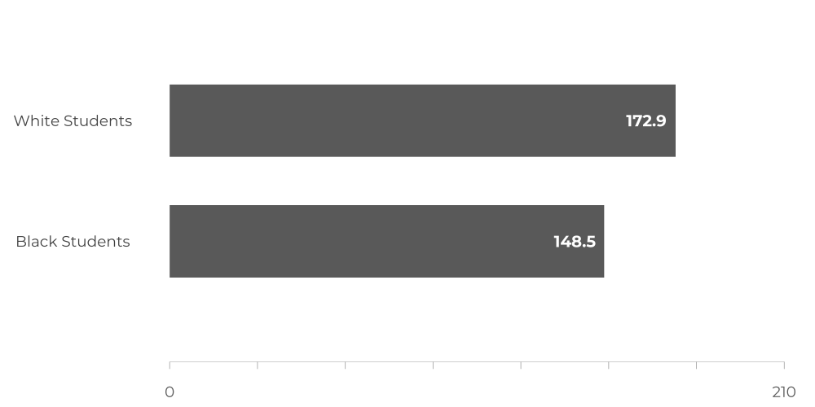
Oversimplification in visualization

Slide 26
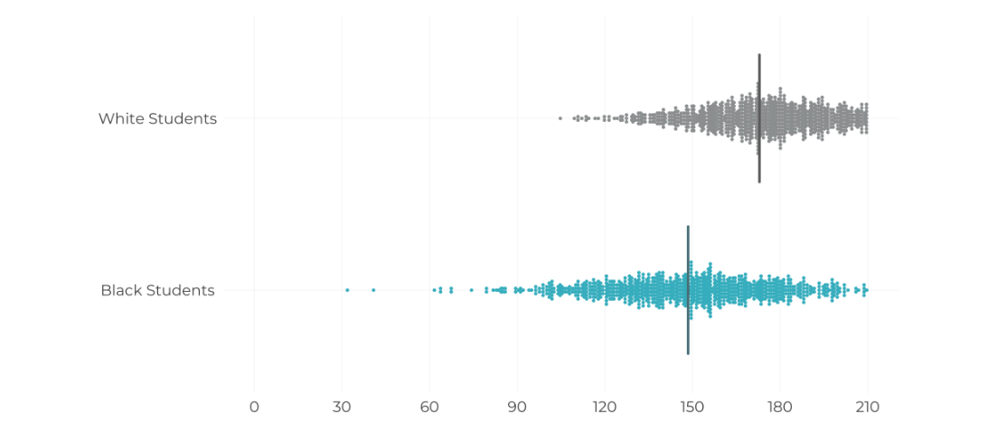
Oversimplification in visualization

Slide 27
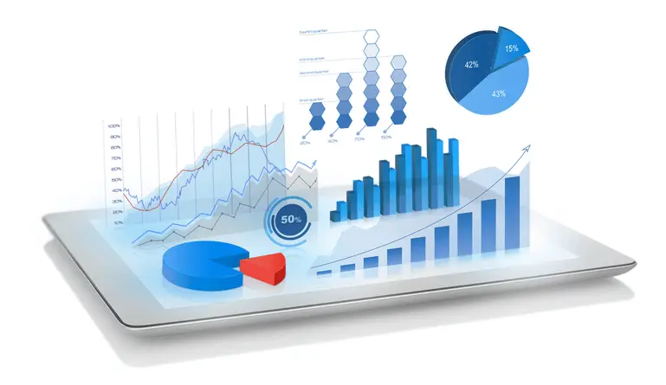
What oversimplification brings
Loss of nuance: hide important details
Misleading trends: create false trends or patterns that don't exist in the actual data
Hide context: removes crucial context that viewers need to interpret the information correctly

Slide 28
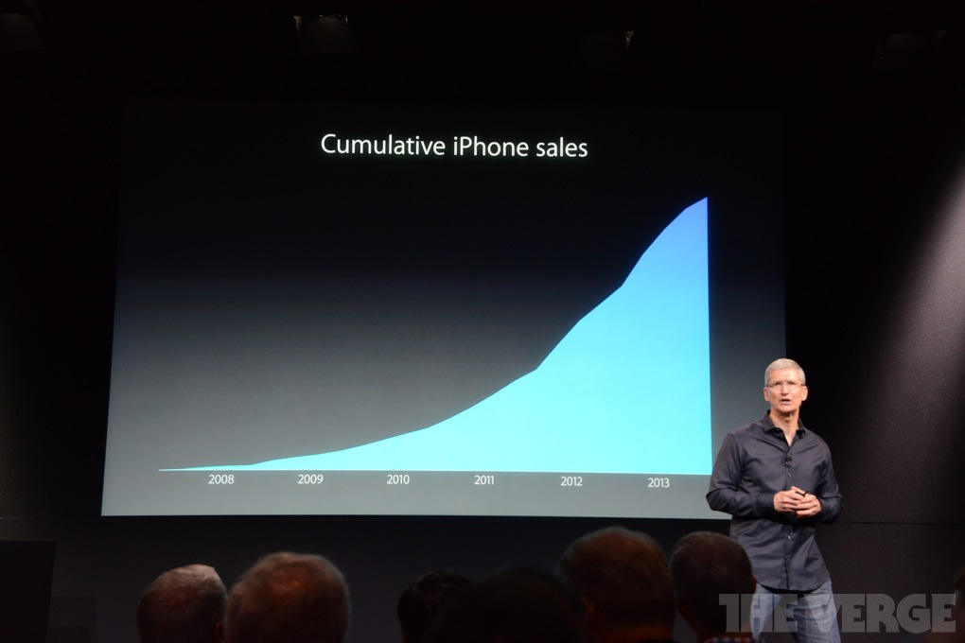
Implicit bias

Slide 29
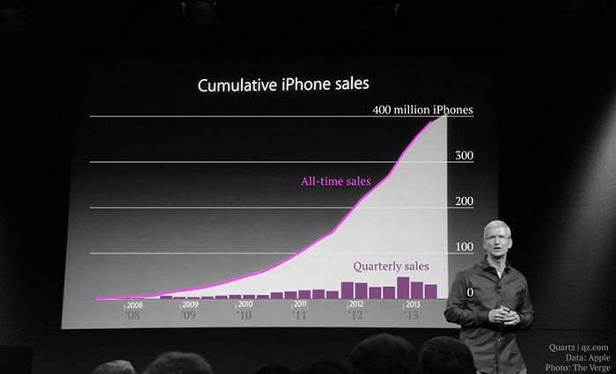
Implicit bias

Slide 30
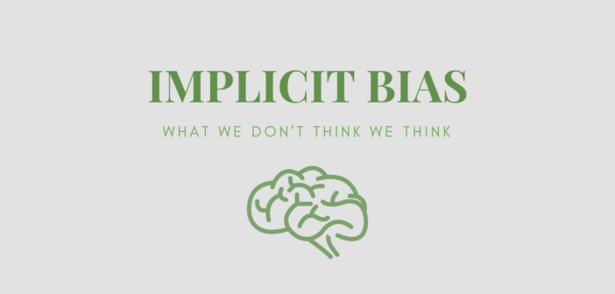
Reasons for implicit bias
Choice of Chart Type: We might subconsciously favor certain chart types that reinforce our pre-existing beliefs.
Color Coding: evoke certain emotions or associations. Picking colors based on stereotypes can introduce bias.
Axis Scaling and Labeling: manipulating the scale or labels on an axis can exaggerate or downplay trends

Slide 31

Try your best to avoid implicit bias
Diverse Perspectives: get feedback from people with different backgrounds and viewpoints on your visualizations.
Data Transparency: be transparent about your data collection and processing methods
Focus on Fairness: Strive to present data in a way that is fair and unbiased

Slide 32
THANKS
Do you have any questions?

